Slide 1
Data Science Interview: Yuchi Huang, Senior Research Scientist, ACT inc.
Interview By: Spencer Swartz,
MSDS Candidate, University of Wisconsin – La Crosse

Slide 2






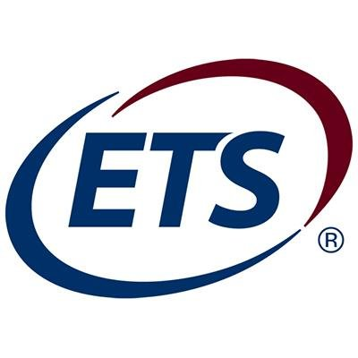
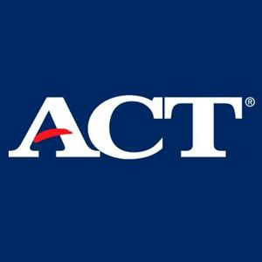
Yuchi Huang - Background
Education
BE, Automatic Control
Beihang University
MS, Pattern Recognition, Computer Vision
University of Chinese Academy of Sciences
MS, Mathematical Finance
Rutgers University
Ph.D, Computer Science
Rutgers University
Career
Computer Scientist – GE Global Research
2010-2012
Senior Researcher – NEC Laboratories
2013-2015
Research Scientist NLP – Educational Testing Service
2015-2017
Senior Research Scientist – ACT
2017-Present

Slide 3
ACT, Inc.
Mission
Helping People Achieve Education and Workplace Success.
About
ACT is a mission-driven, non-profit organization dedicated to helping people achieve education and workplace success. They are trusted as a national leader in college and career readiness, providing high-quality assessments grounded in nearly 60 years of research. While millions of individuals take the ACT test each year, that's just one aspect of their work. From elementary school through career, ACT offers individuals a uniquely integrated set of solutions designed to provide personalized insights throughout their life.

Slide 4
disposition
Yuchi is a research scientist at ACT
His interests include Computer Vision, Natural Language Processing, Automatic Generation of Educational Resources, and Multimodal Analytics for Measurement.
In his current position Yuchi leads research in machine learning and deep learning models in education based research.
Yuchi’s path to becoming a data science researcher was somewhat traditional, once graduating with a Ph.D. in Computer Science and an MS in Computer Vision he immediately started research in the field of Machine Learning and Data Science
His most recently completed research included automatic generations of photorealistic avatars for human agent interaction

Slide 5
professionalism
Yuchi is a leading researcher within the Artificial Intelligence and Machine Learning group at ACT. In this role he is responsible for identifying use cases that will advance both educational learning and testing in the future. He often travels to research based conferences where he meets with others in both the educational testing space as well as those in more traditional Data Science industries.

Slide 6
What I learned
Somewhat different than the last interview, Yuchi seemed to know what he was interested in early on in his education (long before the field of data science really exploded)
It is very interesting to hear where Yuchi believes education could be in the very near future, it is obvious that the industry is ripe for new innovations as there have not been many game changers in recent years.
Yuchi believes that very soon assessment will change as more and more technology enters the space, the latent variable attainment may be able to be tracked in real time as apposed to from point in time tests.

Slide 7
Improving the Flow of Information
Yuchi is a traditional researcher at ACT, this means that most of the information that he gathers is from published journals that his peers work is in. Yuchi is in the forefront of computer vision technology and this requires him to spend a good amount of time reading and reviewing articles in the space. One way he believes would improve the flow of information for himself would be eliminating many of the costs that publishers have created for both writing and reading scientific articles, as it is often money that limits his work.

Slide 8
Data Science At ACT and ACTNExt
As I have stated before Yuchi is a research scientist at ACT, his department, ACTNEXT is tasked with identifying new innovative ways to assess and advance learning progressions for the future of education
This department at one point was the sole group that was implementing Data Science projects at ACT. But now the company has realized the potential for the discipline and has expanded it to all areas of the company’s operations.
Given this information it truly is and exciting time at ACT, as data science is just starting to become mainstream at the company.

